Slide 1


Slide 2
Mark 2:18-22 (ICB)
Jesus’ Followers Are Criticized
¹⁸ One day the followers of John and the Pharisees were giving up eating. Some people came to Jesus and said, “John’s followers and the followers of the Pharisees give up eating. But your followers don’t. Why?”
¹⁹ Jesus answered, “When there is a wedding, the friends of the bridegroom are not sad while he is with them. They do not give up eating while the bridegroom is still there. ²⁰ But the time will come when the bridegroom will leave them. Then the friends will be sad and will give up eating.

Slide 3
Mark 2:18-22 (cont…)
²¹ “When a person sews a patch over a hole on an old coat, he never uses a piece of cloth that is not yet shrunk. If he does, the patch will shrink and pull away from the coat. Then the hole will be worse. ²² Also, no one ever pours new wine into old leather bags for holding wine. If he does, the new wine will break the bags, and the wine will be ruined along with the bags for the wine. People always put new wine into new leather bags.”

Slide 4
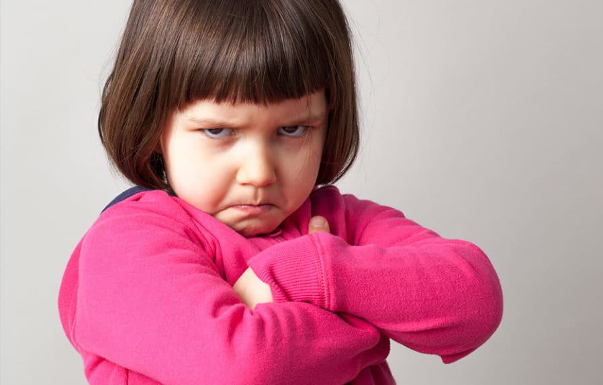
It’s not fair!!!

Slide 5
Mum has been kind to give you a chocolate biscuit. You ask for another one and Mum says no. How do you respond?

Slide 6
Mum has been kind to give you a chocolate biscuit. You ask for another one and Mum says no. How do you respond?
OK Mum, I understand you have my best interests at heart when it comes to my health. Thank you for thinking of me.

Slide 7
Mum has been kind to give you a chocolate biscuit. You ask for another one and Mum says no. How do you respond?
OK Mum, I understand you have my best interests at heart when it comes to my health. Thank you for thinking of me.
It’s not fair!

Slide 8
Dad has allowed you to have an extra half an hour of screen time. You ask for another half an hour and Dad says no. How do you respond?

Slide 9
Dad has allowed you to have an extra half an hour of screen time. You ask for another half an hour and Dad says no. How do you respond?
OK Dad, I understand too much screen time is bad for me. I’ll turn it off right now like the good child you know me to be.

Slide 10
Dad has allowed you to have an extra half an hour of screen time. You ask for another half an hour and Dad says no. How do you respond?
OK Dad, I understand too much screen time is bad for me. I’ll turn it off right now like the good child you know me to be.
It’s not fair!

Slide 11
You’re at Nanny and Grandad’s house…

Slide 12
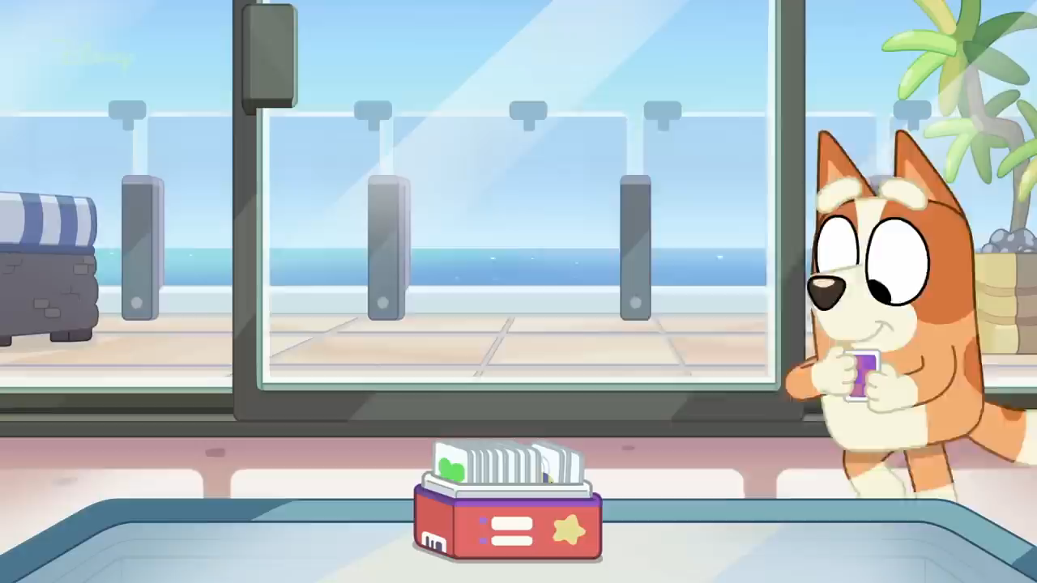

Slide 13


Slide 14
Why didn’t Jesus’ disciples fast?
Why do some Christians fast?
What do we learn from fasting?
How do we fast?

Slide 15
1) Why didn’t Jesus’ disciples fast?
Mark 2:18-20
¹⁸ One day the followers of John and the Pharisees were giving up eating. Some people came to Jesus and said, “John’s followers and the followers of the Pharisees give up eating. But your followers don’t. Why?”
¹⁹ Jesus answered, “When there is a wedding, the friends of the bridegroom are not sad while he is with them. They do not give up eating while the bridegroom is still there. ²⁰ But the time will come when the bridegroom will leave them. Then the friends will be sad and will give up eating.

Slide 16
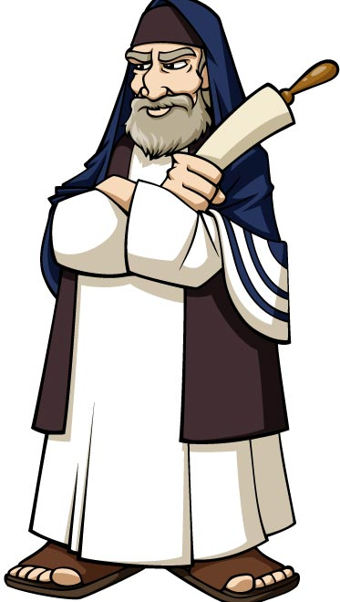
Pharisee – ‘Separated One’

Slide 17

Pharisee – ‘Separated One’
Rules upon rules upon rules

Slide 18
John 3:16-17 (NIV)
¹⁶ For God so loved…

Slide 19
John 3:16-17 (NIV)
¹⁶ For God so loved the world that he gave his one and only Son, that whoever believes in him shall not perish but have eternal life.

Slide 20
John 3:16-17 (NIV)
¹⁶ For God so loved the world that he gave his one and only Son, that whoever believes in him shall not perish but have eternal life.
¹⁷ For God did not send his Son into the world to condemn the world, but to save the world through him.

Slide 21
Mark 2:18-20
¹⁸ One day the followers of John and the Pharisees were giving up eating. Some people came to Jesus and said, “John’s followers and the followers of the Pharisees give up eating. But your followers don’t. Why?”
¹⁹ Jesus answered, “When there is a wedding, the friends of the bridegroom are not sad while he is with them. They do not give up eating while the bridegroom is still there. ²⁰ But the time will come when the bridegroom will leave them. Then the friends will be sad and will give up eating.

Slide 22
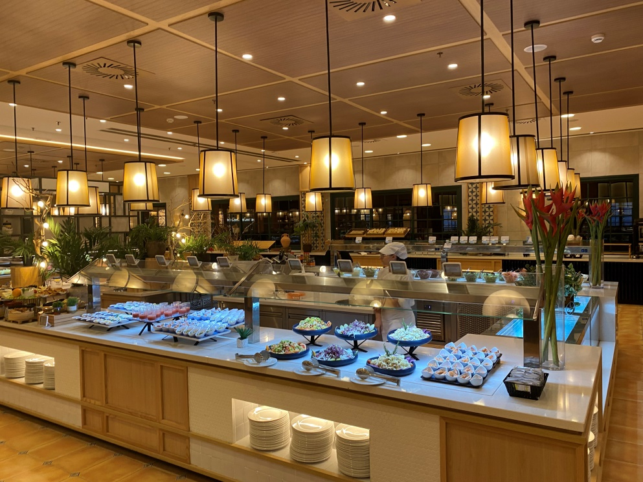
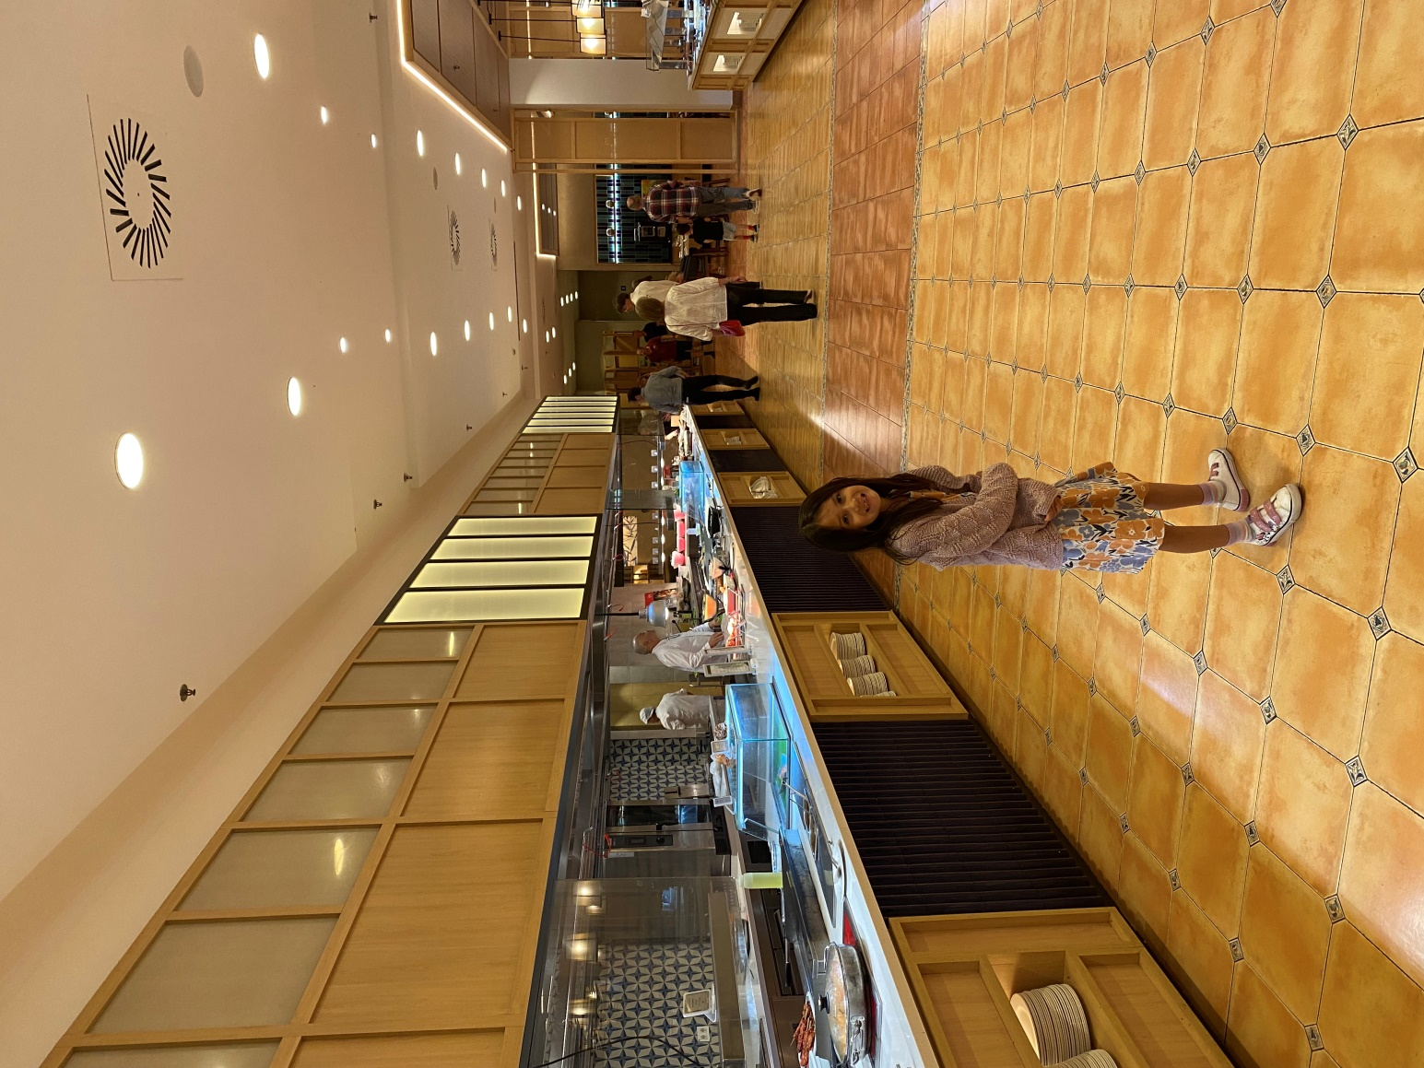
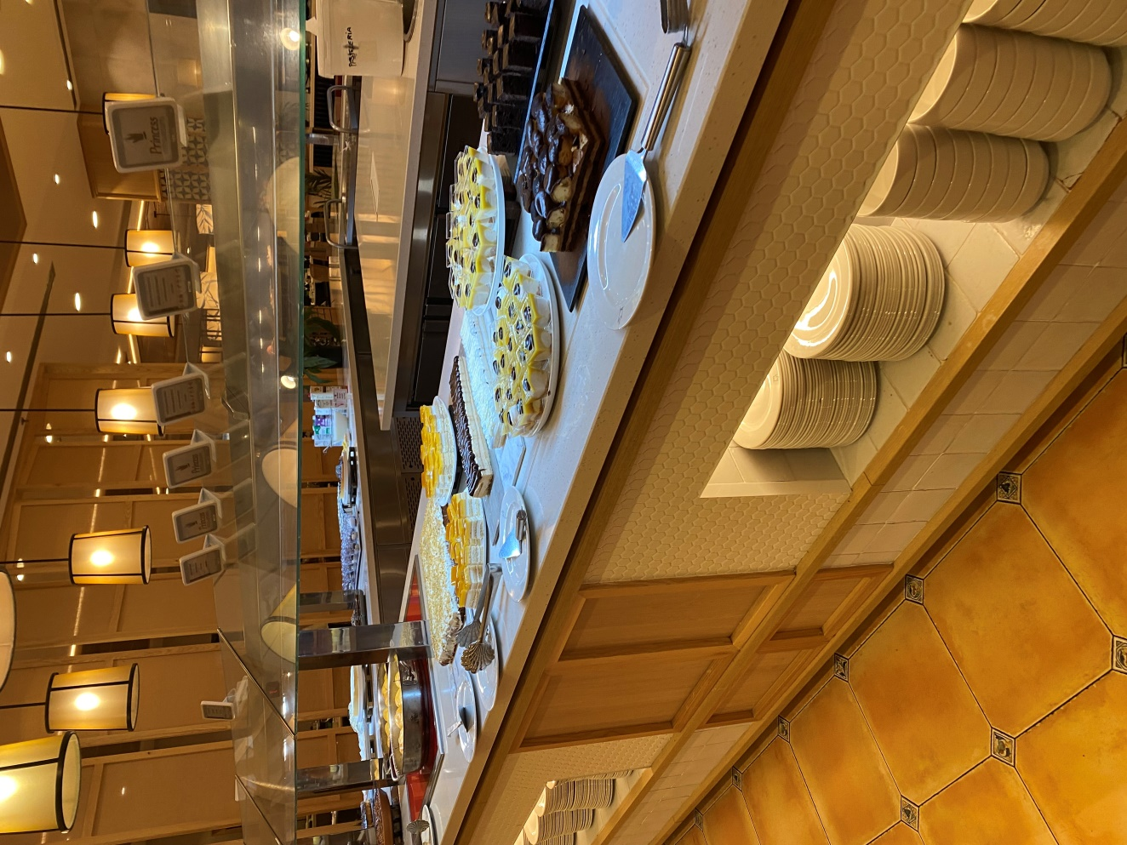

Slide 23
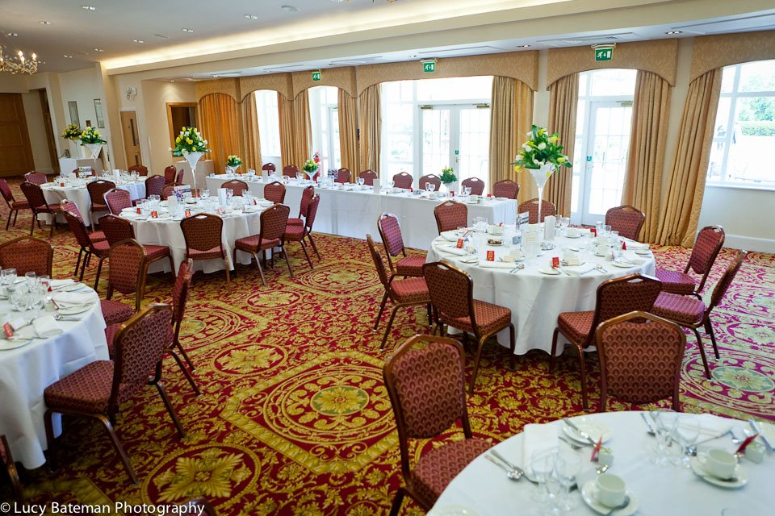

Slide 24
Mark 2:18-20
¹⁸ One day the followers of John and the Pharisees were giving up eating. Some people came to Jesus and said, “John’s followers and the followers of the Pharisees give up eating. But your followers don’t. Why?”
¹⁹ Jesus answered, “When there is a wedding, the friends of the bridegroom are not sad while he is with them. They do not give up eating while the bridegroom is still there. ²⁰ But the time will come when the bridegroom will leave them. Then the friends will be sad and will give up eating.

Slide 25
2) Why do some Christians fast?

Slide 26
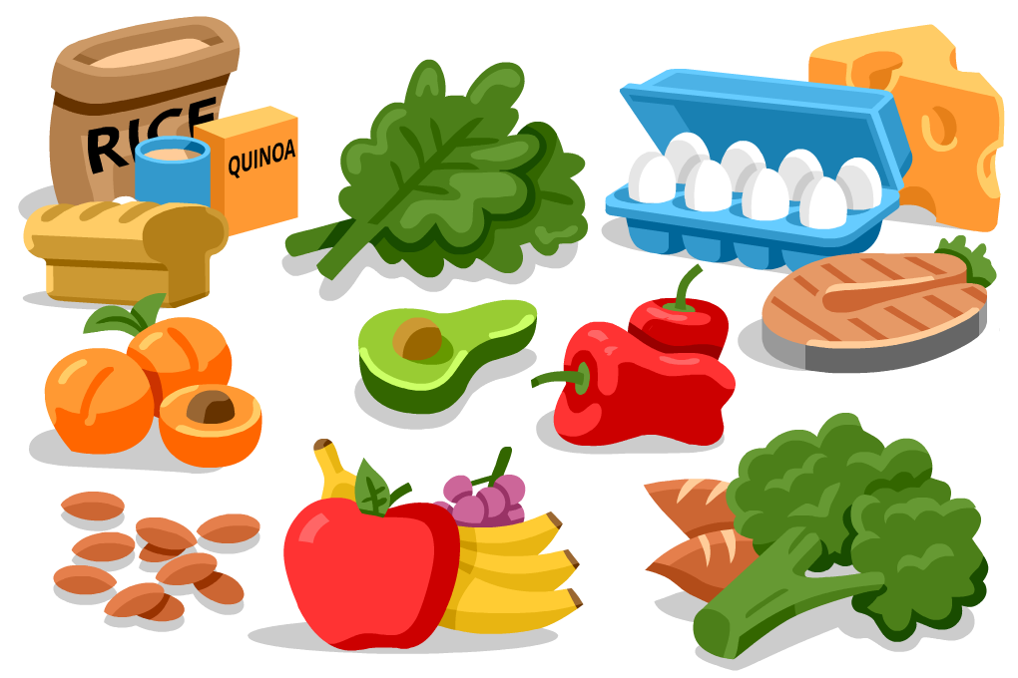
2) Why do some Christians fast?
We need food to exist…

Slide 27
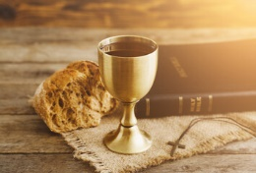
2) Why do some Christians fast?
We need food to exist…
… but we need to
depend on God more!

Slide 28
Matthew 4:4 (NIV)
⁴ Jesus answered, “It is written: ‘Man shall not live on bread alone, but on every word that comes from the mouth of God.’”

Slide 29
Mark 2:18-20
¹⁸ One day the followers of John and the Pharisees were giving up eating. Some people came to Jesus and said, “John’s followers and the followers of the Pharisees give up eating. But your followers don’t. Why?”
¹⁹ Jesus answered, “When there is a wedding, the friends of the bridegroom are not sad while he is with them. They do not give up eating while the bridegroom is still there. ²⁰ But the time will come when the bridegroom will leave them. Then the friends will be sad and will give up eating.

Slide 30
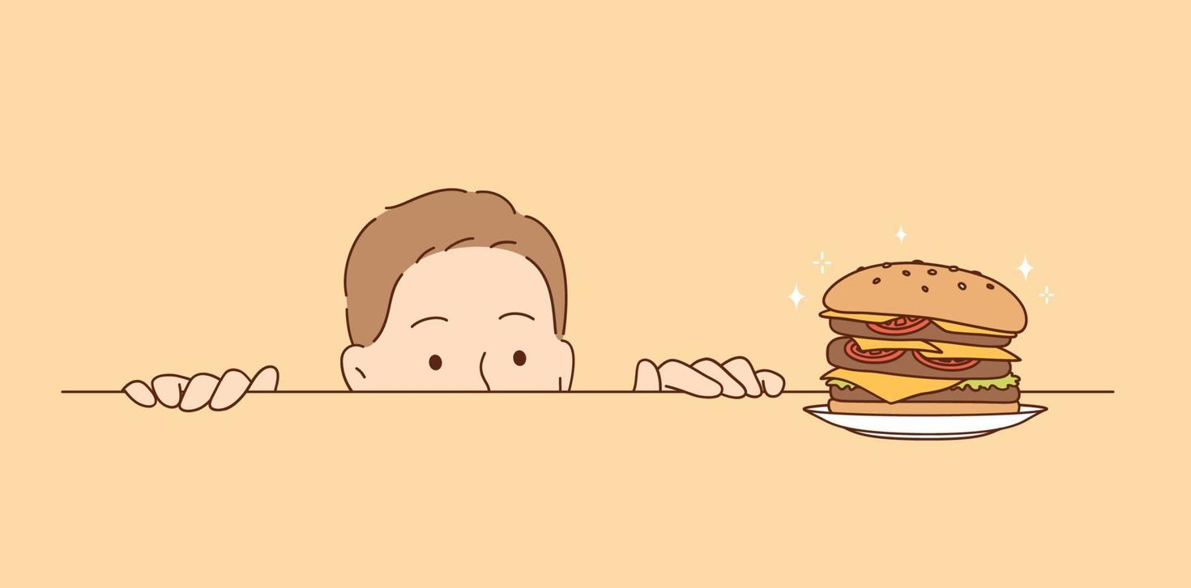
Without a purpose and a plan, it’s not Christian fasting, it’s just going hungry!

Slide 31
To seek God’s guidance and wisdom (Acts 13:2-3)
To express repentance and return to God
To humble oneself before God (Psalm 35:13)
To seek deliverance from a situation (1 Kings 19:8)
To overcome temptation
To express love and worship (Luke 2:36-38)

Slide 32
What do we learn from fasting?

Slide 33
What do we learn from fasting?
JESUS CHANGES EVERYTHING!

Slide 34
What do we learn from fasting?
JESUS CHANGES EVERYTHING!
2 Corinthians 5:17 (NIV)
¹⁷ Therefore, if anyone is in Christ, the new creation has come: The old has gone, the new is here!

Slide 35
Mark 2:21-22
²¹ “When a person sews a patch over a hole on an old coat, he never uses a piece of cloth that is not yet shrunk. If he does, the patch will shrink and pull away from the coat. Then the hole will be worse. ²² Also, no one ever pours new wine into old leather bags for holding wine. If he does, the new wine will break the bags, and the wine will be ruined along with the bags for the wine. People always put new wine into new leather bags.”

Slide 36
Matthew 22:37-40 (NIV)
³⁷ …“‘Love the Lord your God with all your heart and with all your soul and with all your mind.’ ³⁸ This is the first and greatest commandment. ³⁹ And the second is like it: ‘Love your neighbour as yourself.’ ⁴⁰ All the Law and the Prophets hang on these two commandments.”

Slide 37
Mark 2:21-22
²¹ “When a person sews a patch over a hole on an old coat, he never uses a piece of cloth that is not yet shrunk. If he does, the patch will shrink and pull away from the coat. Then the hole will be worse. ²² Also, no one ever pours new wine into old leather bags for holding wine. If he does, the new wine will break the bags, and the wine will be ruined along with the bags for the wine. People always put new wine into new leather bags.”

Slide 38
4) How do we fast?

Slide 39
4) How do we fast?
Matthew 6:16-18 (NIV)
¹⁶ “When you fast, do not look sombre as the hypocrites do, for they disfigure their faces to show others they are fasting. Truly I tell you, they have received their reward in full. ¹⁷ But when you fast, put oil on your head and wash your face, ¹⁸ so that it will not be obvious to others that you are fasting, but only to your Father, who is unseen; and your Father, who sees what is done in secret, will reward you.

Slide 40
Types of fasting:
Absolute
Partial
Daniel
Intermittent and…..
???

Slide 41
Types of fasting:
Absolute
Partial
Daniel
Intermittent and…..
Facebook? TikTok? Gaming?

Slide 42
Hints and Tips
Start small
Plan what you’ll do instead
Consider how it will affect others
Try different kinds of fasting
Don’t think about the elephant in the room!

